Slide 1

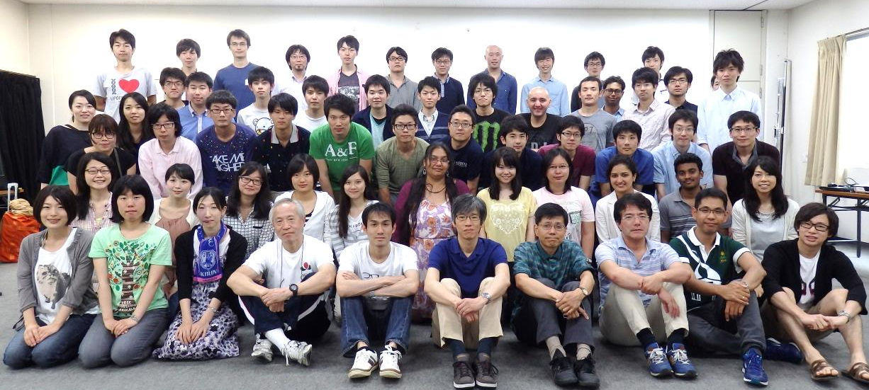
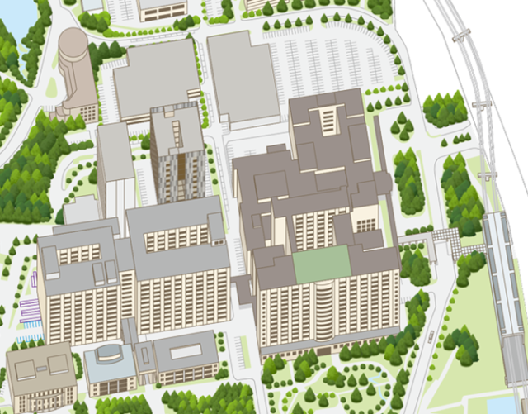
PROGRAM FOR LEADING GRADUATE SCHOOLS
INTERDISCIPLINARY PROGRAM FOR BIOMEDICAL SCIENCES
( IPBS )
IPBS Fair
for G30 students
We are having a social for you to meet the current IPBS students,
young faculty members and our coordinator, Professor Kiyoshi Takeda.
It is an informal event, so please come and join to have conversation with us!
We will also take a quick tour of our new Innovation and Research building!
DATE : Friday, August 7, 2015, 14:00-16:00
LOCATION :
Osaka University Suita Campus, Room 4(0311), 3rd Floor
The Center of Medical Innovation and Translational Research (CoMIT)
We look forward to
meeting and talking
with you !!
Photo: IPBS Retreat, 2015
【Map】
CoMIT
We will have some refreshment.
Feel free to stop by anytime and
you may leave anytime!
Graduate School
Of Medicine
Monorail
Handai Byoin
Mae
【Any inquiries may be addressed to 】
IPBS administrative Office
Phone: 06-6210-8230,Email: seitai@stn.osaka-u.ac.jp
Website: http://www.stn.osaka-u.ac.jp/english/index.html
Osaka University
Hospital

